Slide 1

Music Store Analysis
By Kasoju Sai Teja

Slide 2
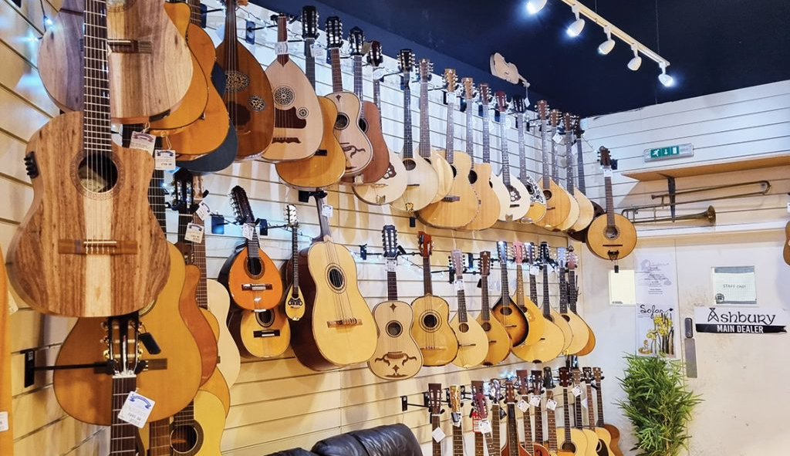
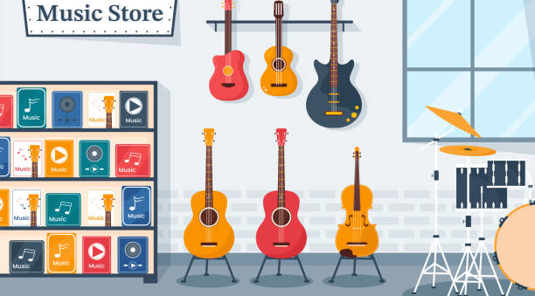
Project Overview
The primary objective of this project is to delve into the music playlist database and extract meaningful information using SQL queries. By doing so, we aim to gain a deeper understanding of the store's performance, customer preferences, and overall business trends.
Database: The music playlist database, which contains crucial information about the store's inventory, sales, and customer interactions.
SQL Tool : MYSQL Work Bench, a powerful and user-friendly tool for managing and querying relational databases.
Data Source: CSV files will serve as the source of data for our analysis, providing structured information that can be easily imported into our database for further processing.

Slide 3
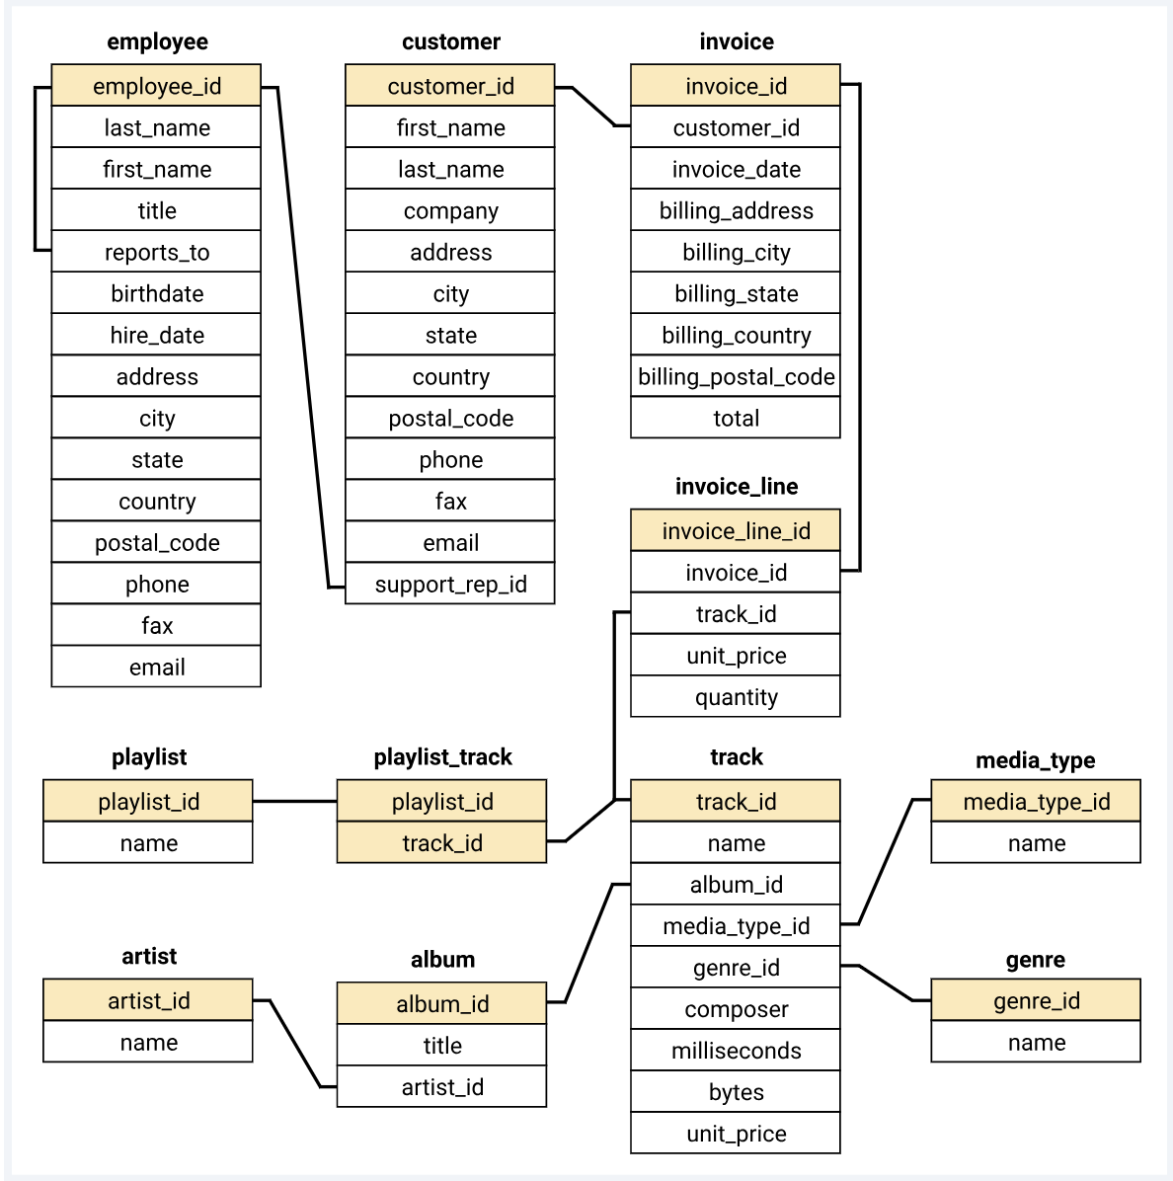
Scheme Diagram

Slide 4

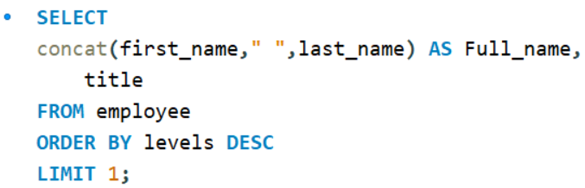
Question Set - 1
1. Who is the senior most employee based on job title?
Output
Input

Slide 5
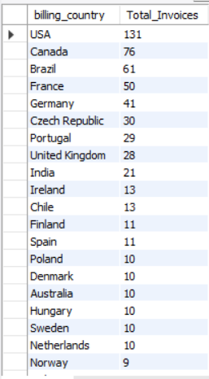
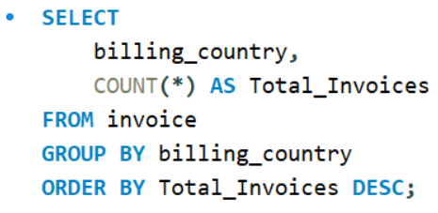
Question Set - 1
2. Which countries have the most Invoices?
Output
Input

Slide 6
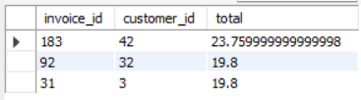
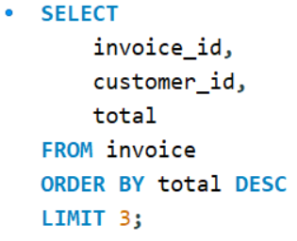
Question Set - 1
3. What are top 3 values of total invoice?
Output
Input

Slide 7

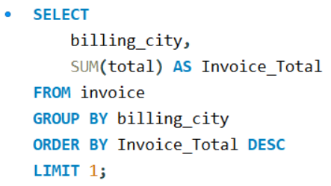
Question Set - 1
4. Which city has the best customers? We would like to throw a promotional Music Festival in the city we made the most money. Write a query that returns one city that has the highest sum of invoice totals. Return both the city name & sum of all invoice totals
Output
Input

Slide 8

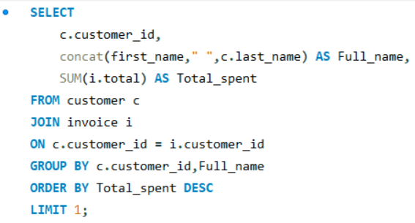
Question Set - 1
5. Who is the best customer? The customer who has spent the most money will be declared the best customer. Write a query that returns the person who has spent the most money
Output
Input

Slide 9
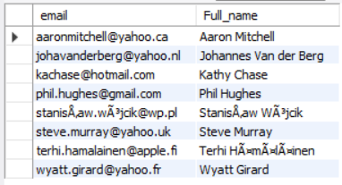
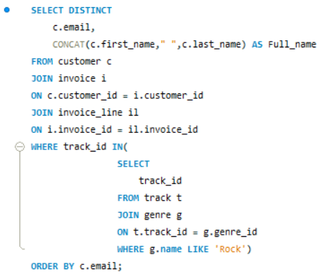
Question Set - 2
1. Write query to return the email, first name, last name, & Genre of all Rock Music listeners. Return your list ordered alphabetically by email starting with A
Output
Input

Slide 10
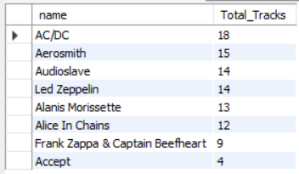
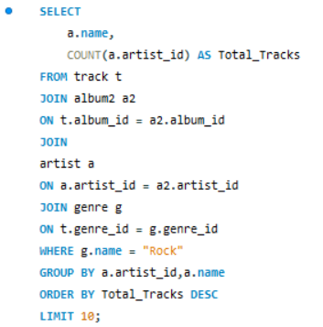
Question Set - 2
2. Let's invite the artists who have written the most rock music in our dataset. Write a query that returns the Artist name and total track count of the top 10 rock bands
Output
Input

Slide 11
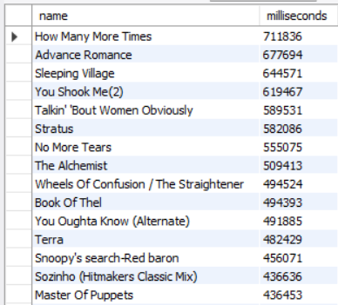
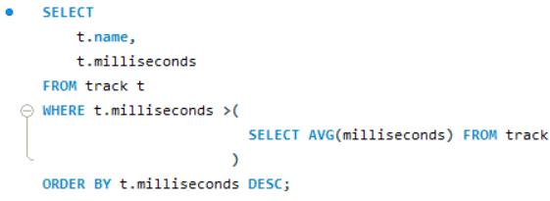
Question Set - 2
3. Return all the track names that have a song length longer than the average song length. Return the Name and Milliseconds for each track. Order by the song length with the longest songs listed first
Output
Input

Slide 12
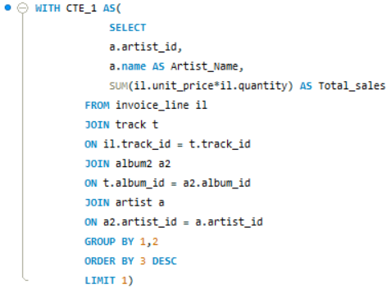
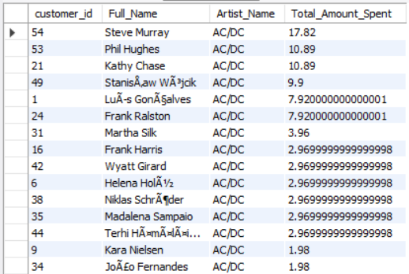
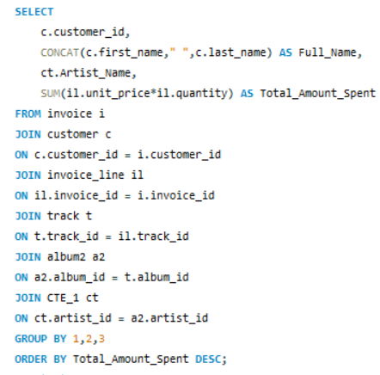
Question Set - 3
1. Find how much amount spent by each customer on artists? Write a query to return customer name, artist name and total spent
Input
Output

Slide 13
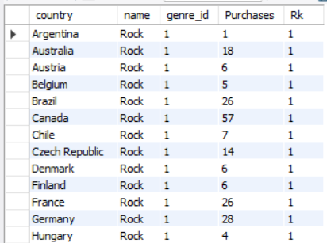
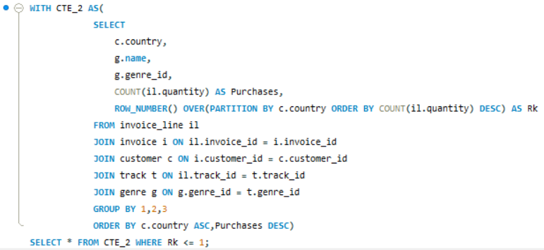
Question Set - 3
2. We want to find out the most popular music Genre for each country. We determine the most popular genre as the genre with the highest amount of purchases. Write a query that returns each country along with the top Genre. For countries where the maximum number of purchases is shared return all Genres
Output
Input

Slide 14
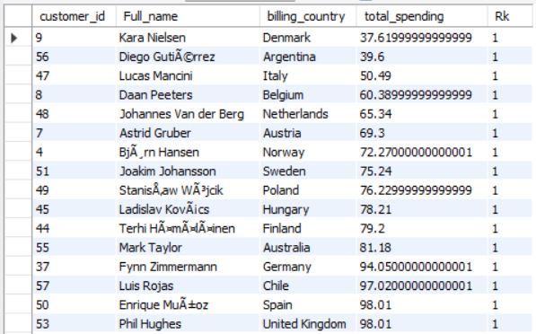
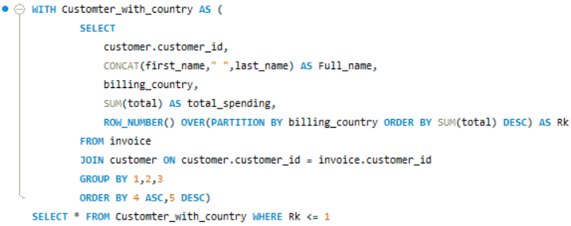
Question Set - 3
3. Write a query that determines the customer that has spent the most on music for each country. Write a query that returns the country along with the top customer and how much they spent. For countries where the top amount spent is shared, provide all customers who spent this amount
Output
Input

Slide 15
Insights and Conclusions for the Music Store Analysis
Senior Most Employee : The senior most employee based on job title is Andrew Adams, holding the position of General Manager.
Top Spending Countries : The countries with the most invoices are USA, Canada, and Brazil, indicating significant sales potential in these regions.
Top 3 Total Invoice Values : The top three total invoice values are $23.76, $19.80, and $19.80, indicating substantial purchases.
Best Customer : František Wichterlová is the best customer, having spent a total of $144.54.
City with Best Customers : Prague emerges as the city with the highest sum of invoice totals, suggesting it could be a lucrative location for promotional events like music festivals.
Rock Music Listeners : The list of customers who listen to rock music provides valuable insights for targeted marketing and promotions.
Top Rock Bands : AC/DC leads as the top rock band in terms of the number of tracks, followed by Aerosmith and Audioslave.
Longest Tracks : The query reveals the longest tracks in terms of song length, which could be useful for playlist curation or understanding customer preferences.
Customer Spending on Artists : Steve Murray has spent the most on the AC/DC artist, followed by other customers with significant spending amounts.
Popular Genres by Country : Rock emerges as the most popular genre in various countries, indicating its widespread appeal across different regions.
Top Spending Customers by Country : The top spending customers in each country highlight potential high-value markets and customer segments.

Slide 16
Based on the Insights, Suggestions for the Music Store Analysis
Targeted Marketing : Focus marketing efforts on countries with high invoice counts and customers with high spending tendencies.
Promotional Events : Organize music festivals or events in cities like Prague, which have demonstrated high invoice totals.
Inventory Management : Stock up on music from popular rock bands like AC/DC, Aerosmith, and Led Zeppelin to cater to customer preferences.
Customer Engagement : Engage with top spending customers to foster loyalty and encourage repeat purchases.
Genre-based Recommendations : Provide personalized recommendations based on popular genres in different regions to enhance customer experience and drive sales.
By leveraging these insights and implementing strategic initiatives, the music store can optimize its operations, enhance customer satisfaction, and drive revenue growth.

Slide 17

Thank You
Kasoju Sai Teja
saitejaas1213@gmail.com
Website : saitejasaii009

